Slide 1

BUSINESS ENGLISH
Topic : Reading “ THE BAKER’S DOZEN”
Goal : comprehension — getting meaning from written text
expand vocabularies
FAKULTAS ILMU KOMPUTER
UNIVERSITAS DIAN NUSWANTORO
SEMARANG

Slide 2
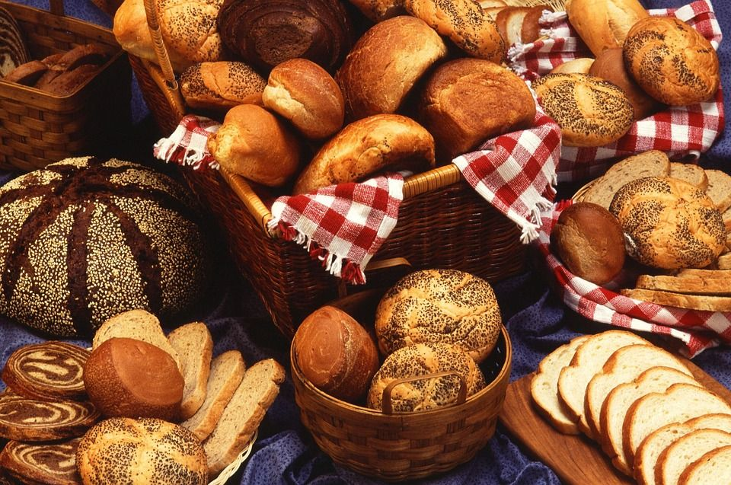
THE BAKER’S DOZEN

Slide 3
Baker’s dozen Ltd’s thirteen outlets bake and sell their own fresh bread and cakes. Revenue has risen quickly since the bakeries started selling to hotels and restaurants as well as the general public. Pastries and pies are selling well. But share holders are finding annual results disapointing. It seems that there is very little leftover to pay dividens or to reinvest in the business as retained profit. So? What is the problem?

Slide 4
The company reports a healthy gross profit, since its cost of goods sold is low: row materials (essentially flour, water, eggs and sugar) are cheap, and most bakery staff are on minimum wage. However, operating profit is much less impresive. As the business has expanded, operating costs, such as rent, electricity, administrative salaries, insurance and marketing have increased considerably. So net profit after text has been a big dissappointment. Not to mention all the money that dissappears in corporation tax and depriciation (the B2B market requires customized vans that lose value very quickly). In conclusion, it seems there’s still profit to be made in baking, but it’s certaintly not easy money.

Slide 5
READING EXERCISE

Slide 6
Vocabularies
Vocabularies | Meaning
Revenue
dividens
Retained profit
Gross profit
Cost of goods sold
Operating profit
Operating cost
Net profit after text
Text and depreciation

Slide 7
Use the word below and match with the article no 1-9
Revenue dividens retained profit gross profit cost of good sold operating profit operating costs net profit after text tax and depreciation
Money from customers
Direct costs, e.g. Materials and labour
Profit or loss after direct costs
Other costs, e.g. Administration, building, utilities
Profit or loss after direct and other costs
Money paid to government and loss in value equipment
Profit or loss after all costs and taxes
Money distributed to shareholders
Money reinvested in the company

Slide 8
VISIT THE VIDEO
https://www.youtube.com/watch?v=9T_JDBl9sv8

